Slide 1
Final Presentation
That One Company Inc.
Michael Merritt, Jonathan Mason, Omar Rosario, William Siri

Slide 2

Overview (Team Members)
Team Members:
Michael Merritt
Role: Scrum Master
Strengths: Leadership
Weaknesses: Rarely asks for help
Omar Rosario
Role: Programmer
Strengths: Presentation
Weaknesses: Consistency
Jonathan Mason
Role: Programmer
Strengths: Humility
Weaknesses: Time management
William Siri
Role: Programmer
Strengths: Coding
Weaknesses: Communication

Slide 3

Overview (Bug and Enhancement Prioritization)
Before starting work on this project, we gathered input from users of different experience levels with games.
Priorities were set towards the following:
Game breaking bugs
Level collisions fix
Inexperienced users
Instruction screen update
“Quality of Life” improvements
Mute button

Slide 4

Overview (Project Management Plan)
Project Management Plan:
Strategy: We used the scrum method of project management.
Scrum master
Each member assigned a task
2 week “scrum sprints”
Presentations
Tools: The tools we used to manage the project were Discord, Zoom, Git, OneDrive, and Google Docs.

Slide 5

Overview (Testing Plan)
A unit test was written for each bug and enhancement.
Each team member would fill out a unit test for another team member’s bug or enhancement to confirm that it worked on other members’ computers.
Features that passed would be merged into the master branch while features did not pass were pushed to a later sprint.

Slide 6
Process

Slide 7
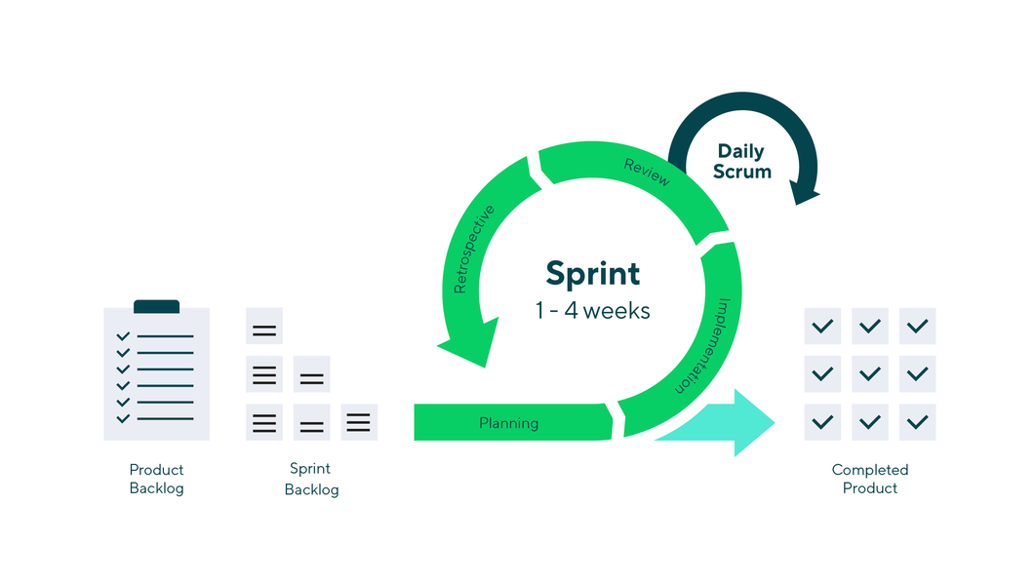
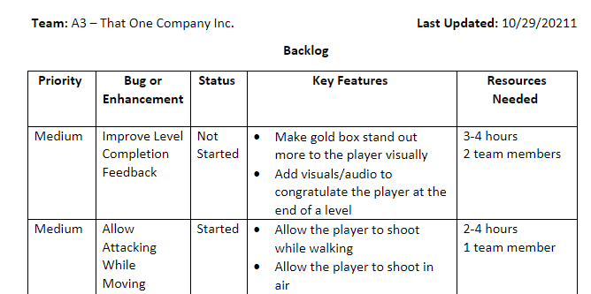
Management Strategy - Scrum Basics
The development process was handled by following the scrum model
Each sprint was two weeks long
Scrum master ran stand-ups at once a week during in-class meetings
During stand-ups, we checked in on progress, future plans, and potential obstacles
Backlog of features to implement was tracked before and after each sprint

Slide 8


Management Strategy - Sprint Schedule
Every scrum sprint consisted of at least three major meetings and a presentation day
Tuesday, Week 1 - Planning Day
Made workplan, assigned tasks, listed NSI in form
Thursday, Week 1 - Initial Check-in
Stand-up for week 1 to discuss implementation progress and plans
Tuesday, Week 2 - Merge Meeting
Stand-up for week 2 to test, merge, and finalize features
Thursday, Week 2 - Presentation
In-class demonstration of improvements and description of work completed this sprint

Slide 9




Management Strategy - Collaboration Tools
Git/GitHub
Used for asynchronous software development and version control
Google Docs/Slides
Used for real-time collaboration when working on reports/presentations
Zoom
Used for virtual presentations, presentation recordings, and in-class meetings
Discord
Used for team communications outside of class as well as additional meetings

Slide 10
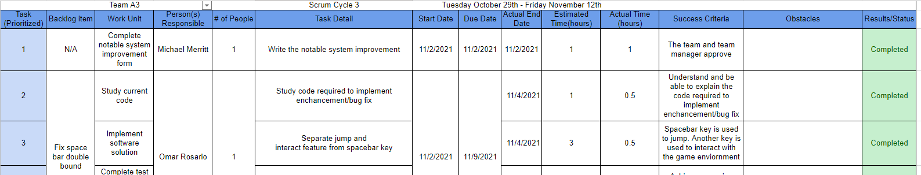
Project Work Plan
Each sprint, we made a work plan with the backlog items we planned to work on
The work plan contained the following items:
Work units and corresponding backlog item
Number of and names of team members assigned
Basic task instructions
Completion dates and time taken
Success criteria
Documented obstacles

Slide 11
Results

Slide 12
Contributions
 | Role |  | Work Hours
Michael Merritt | Scrum Master | Unlooped Level 5 Restructured Level 3 Improved Completion Feedback Adjusted Attack Spawn Location Created Level 9 Improved Old Levels Implemented Sound Effects | 80+
Jonathan Mason | Programmer | Improved Instructions Screen Enabled Attacking While Jumping Enabled the Flipping of the Cat Sprite While Jumping Fixed Attack/Walk Animation Created Level 8 Implemented New Music | 46+

Slide 13
Contributions
 | Role |  | Work Hours
Omar Rosario | Programmer | Implemented Level Collisions Implemented Mute Feature Fixed Double-Bound Key Relocated Narrative Screen Created Level 6 Made Minor Changes to Previous Enhancements | 47.5+
William Siri | Programmer | Improved Menu Navigation Implemented Variable Jump Height Implemented a Single Shot Attack Animation Enabled Attacking While Jumping Created Level 7 Modified Level Selection Screen | 44.5+

Slide 14
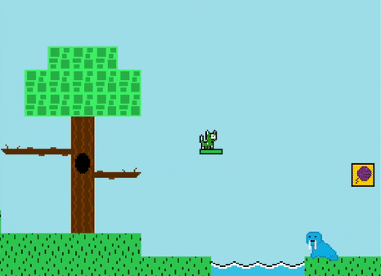
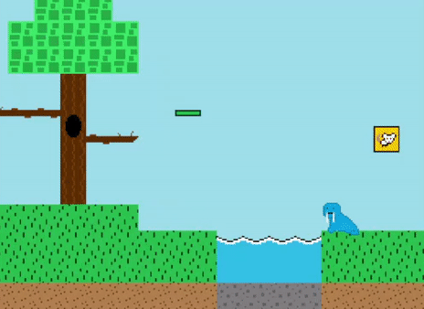
Notable Bug Fix: Level Collisions
ISSUE
The player was able to walk off the level through the right boundary resulting in the player spawning at the beginning of the level or falling under the level’s constructs.
IMPORTANCE
Restricts the player in the game space, keeps the player from repeating the level, or exiting the application game if they were to fall under the map, which is inconvenient for the player to experience.

Slide 15
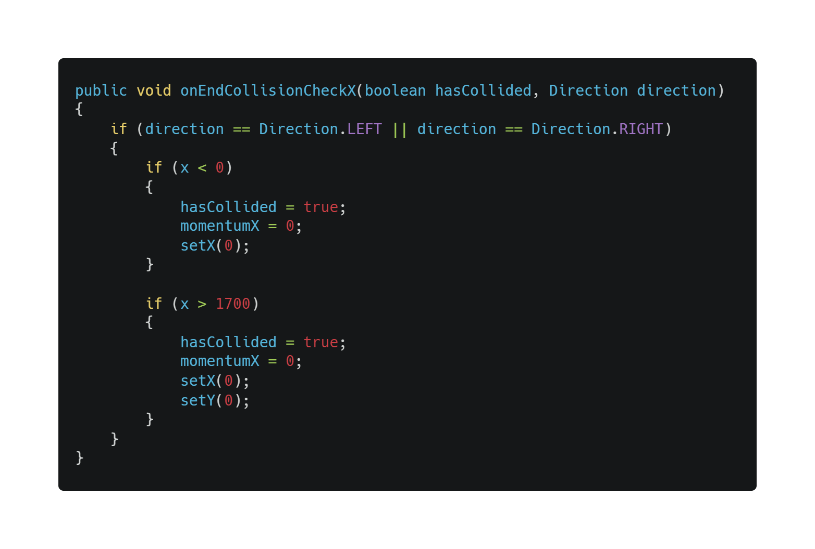
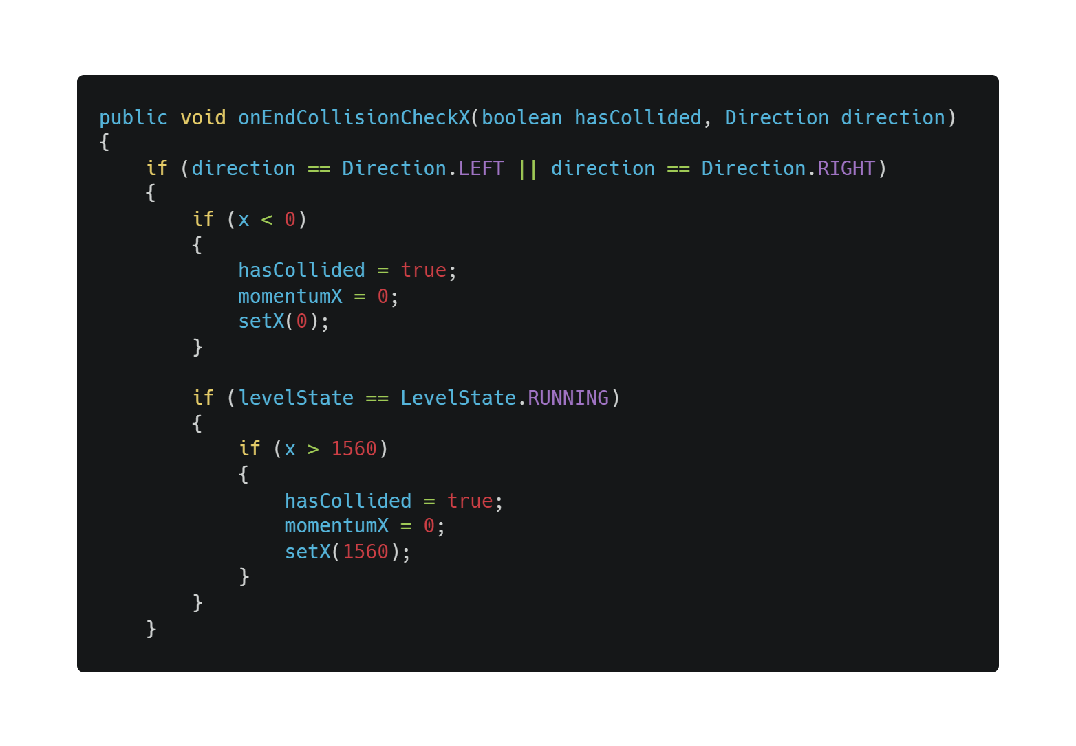
Notable Bug Fix: Level Collisions - Implementation
I had two ways to tackle this bug:
Make collision map tiles, add tiles to every level, implement collision logic…
Restrict player object between two x-coordinates
VERDICT: Restrict player object between two x-coordinates
Before:
After:

Slide 16
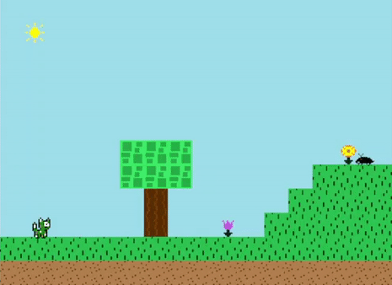
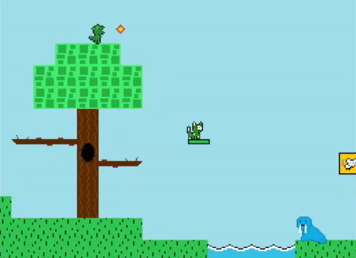
Notable Bug Fix: Level Collisions - Result
LEFT:
RIGHT:

Slide 17
Other Fixed Bugs
Name | Detail | Scrum Sprint
Looping Level 5 | As the final level at the time, the player would constantly repeat Level 5.
Mid-air Sprite Flip | When the player is in the air, the cat sprite does not change orientation when the player moves in the opposite direction. | 3
Walk/Attack Animation | If the player presses the attack key while walking, the animation of the cat sprite will remain in the walking state instead of switching to the standing state. | 3

Slide 18
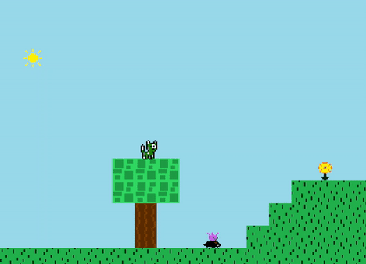
Notable Enhancement: Variable Jump
ISSUE
The player was limited to a singular jump height, despite there being smaller obstacles throughout each level.
IMPORTANCE
Implementing a varying jump height would greatly improve the user’s control over the player and contribute to the capabilities when designing a level.

Slide 19
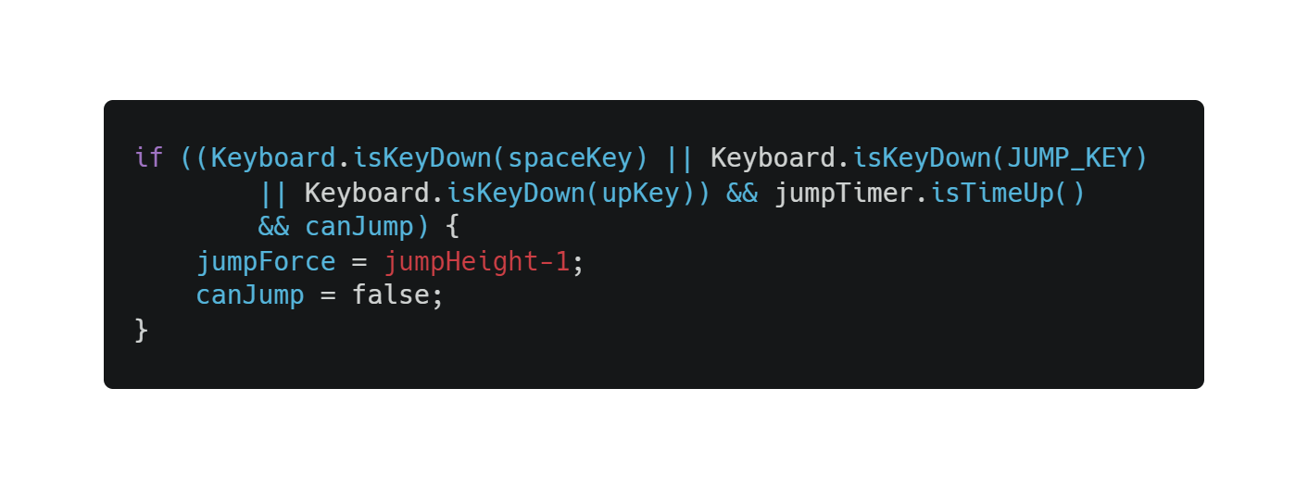
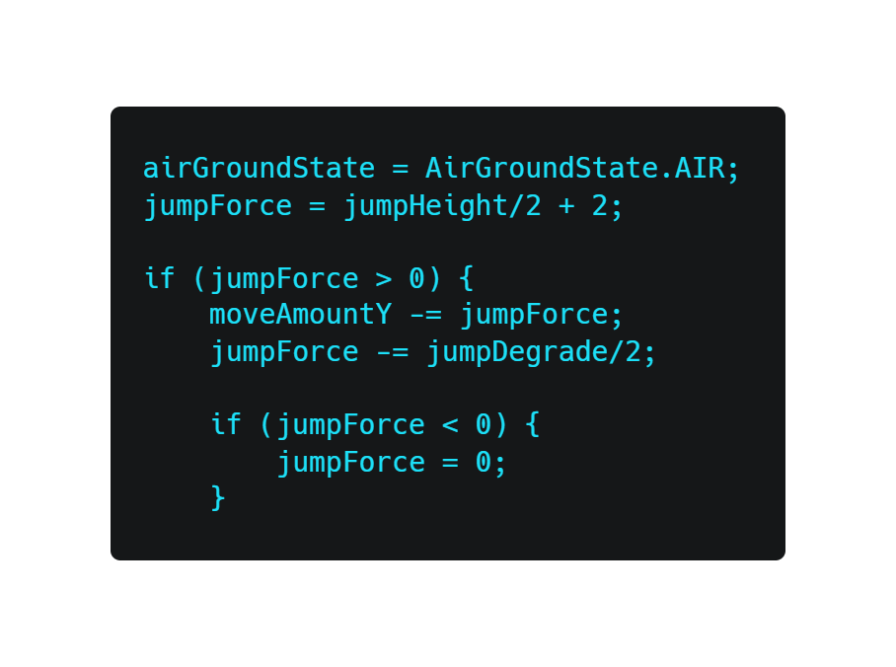
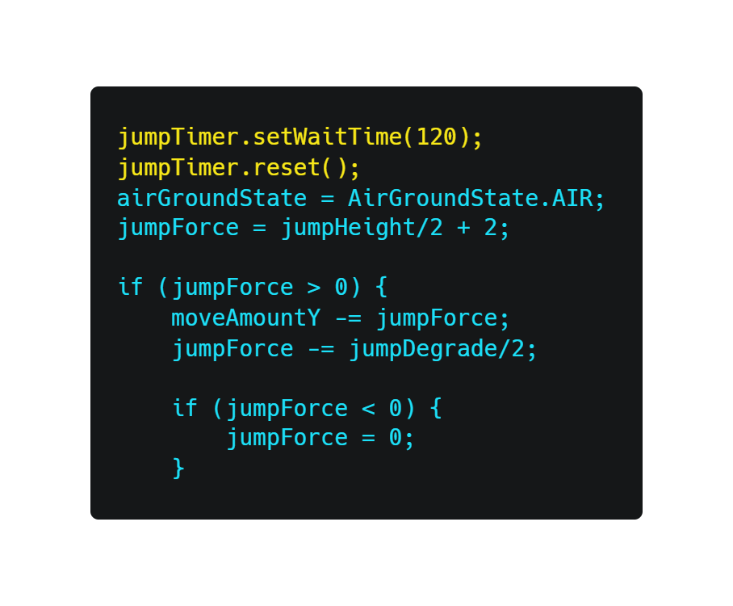
Notable Enhancement: Variable Jump - Implementation
Implemented a timer to detect if the user is still holding the jump button after a certain period
Made additions to the existing jump code to vary the height of the jump based on the duration of the key press
Added a boolean variable that is set to false after the high jump to prevent multiple mid-air jumps
(Inside a conditional statement that detects if the player is touching the ground)
Before:
After:

Slide 20
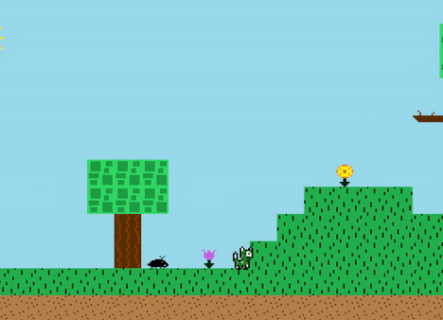
Notable Enhancement: Variable Jump - Result

Slide 21

Notable Enhancement: Game Duration
ISSUE
The game only contained 5 levels. Before bug fixing and enhancing, the team tested the game and decided that there wasn’t enough content in the game.
IMPORTANCE
This improvement is notable because it allows the player to experience some variation, add more challenge, and lengthen play time.

Slide 22
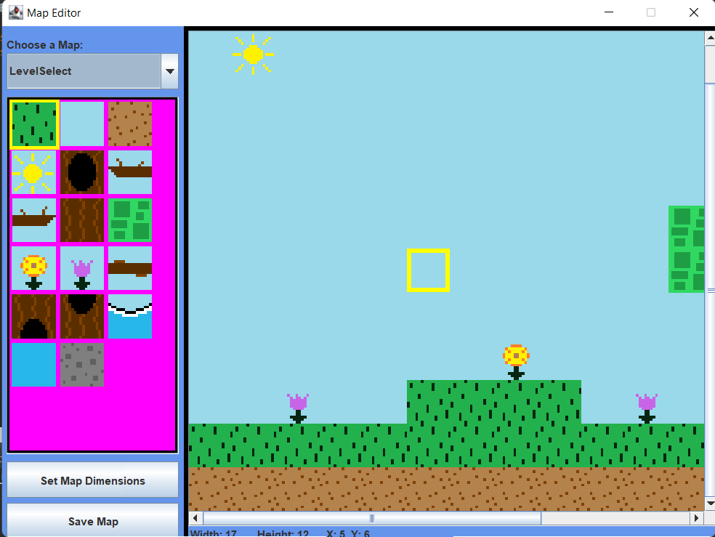
Notable Enhancement: Game Duration - Implementation
Each level was created using an existing Map Editor within the project files
The Map Editor contained all game tiles
Except dynamic game objects (NPCs, moving platforms)
Functioned through a “drag and drop” system which allowed the team to set the dimensions of the level and place tiles
ADDED 4 LEVELS

Slide 23
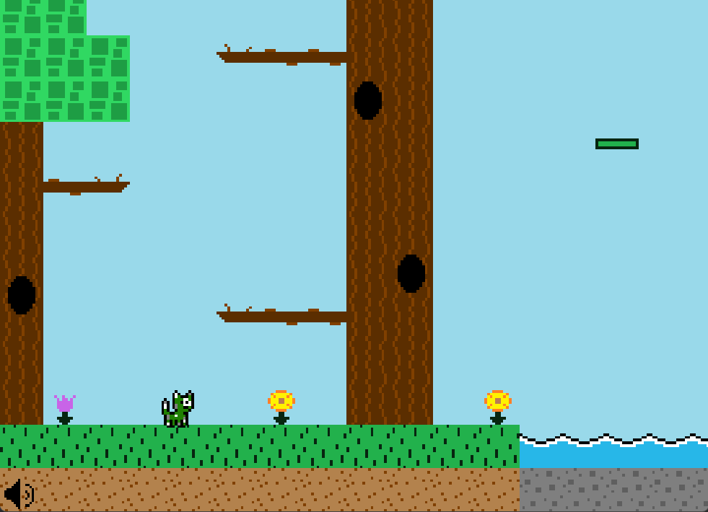
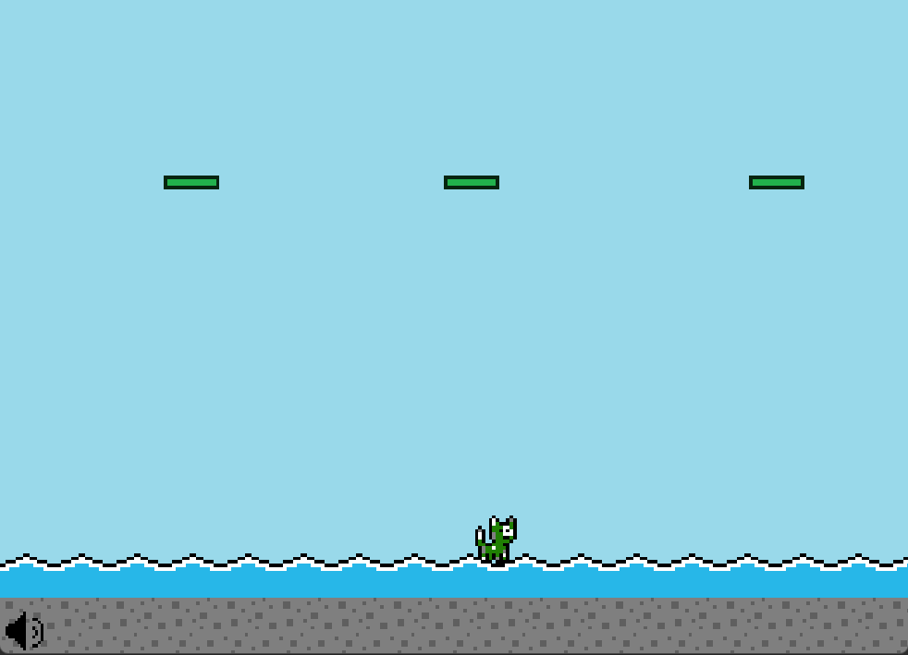
Notable Enhancement: Game Duration - Level 6

Slide 24
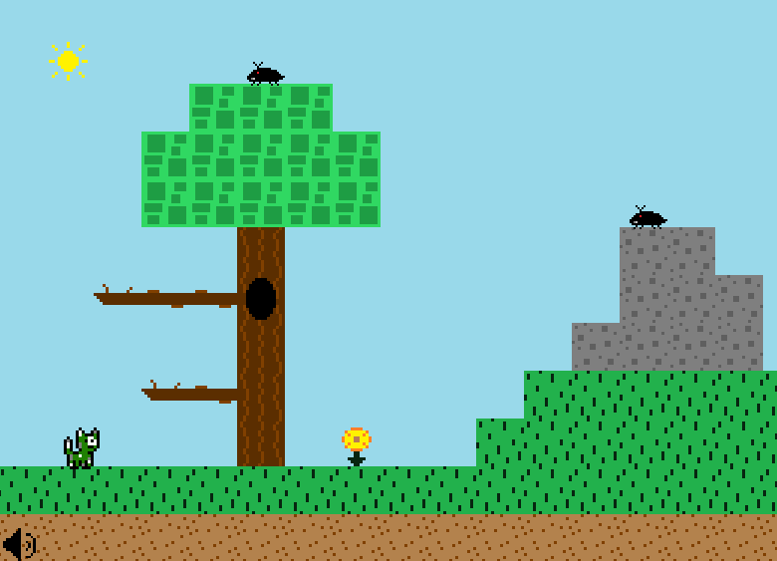
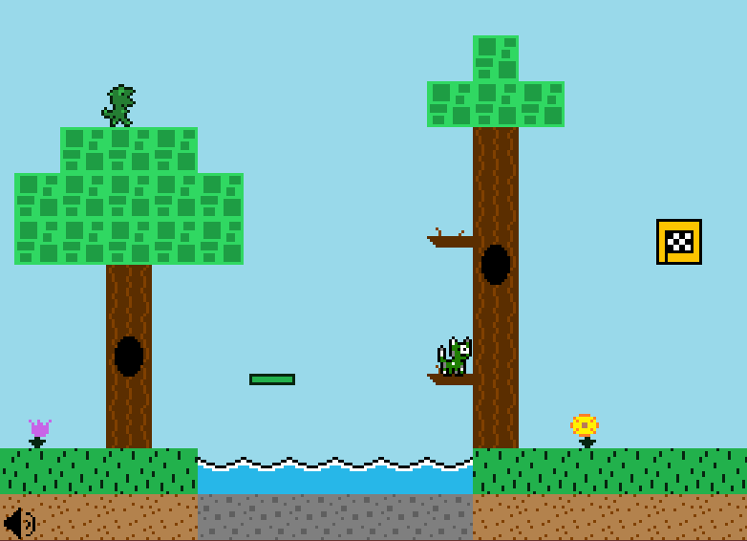
Notable Enhancement: Game Duration - Level 7

Slide 25
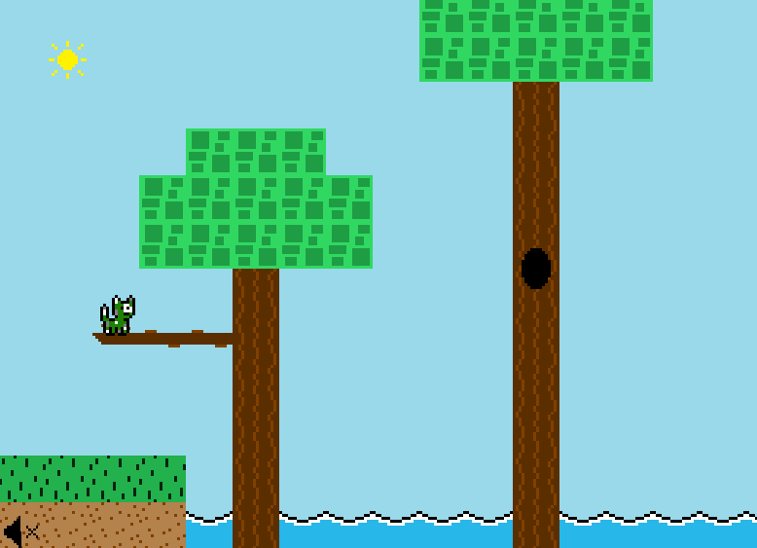
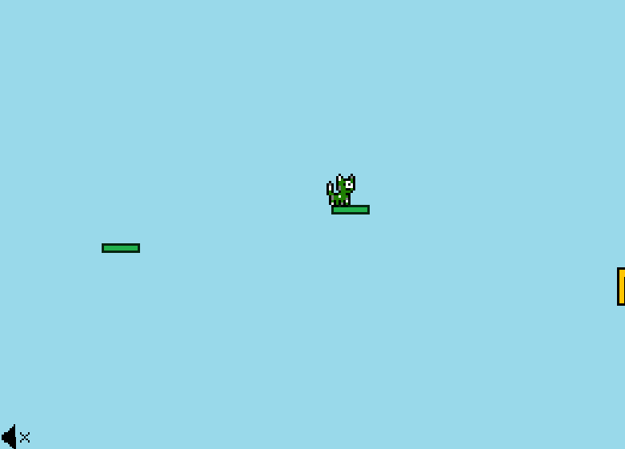
Notable Enhancement: Game Duration - Level 8

Slide 26
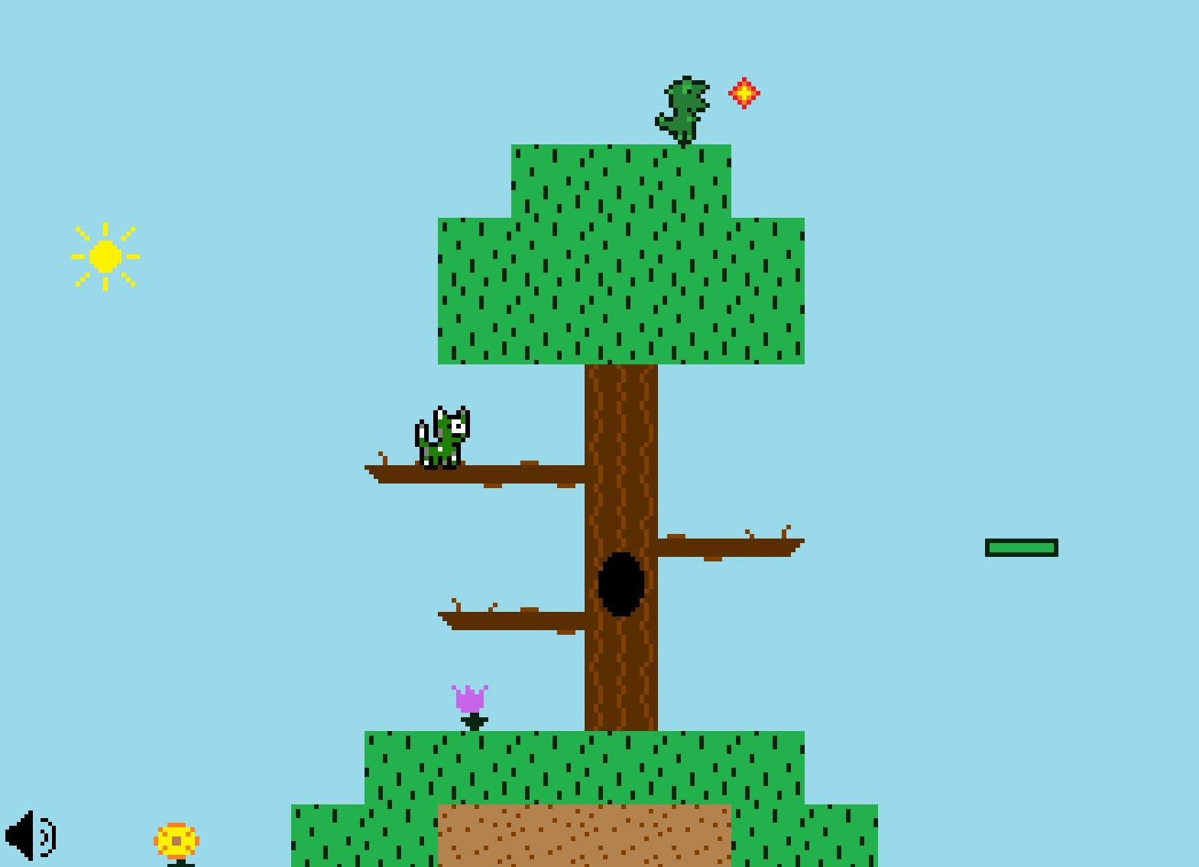
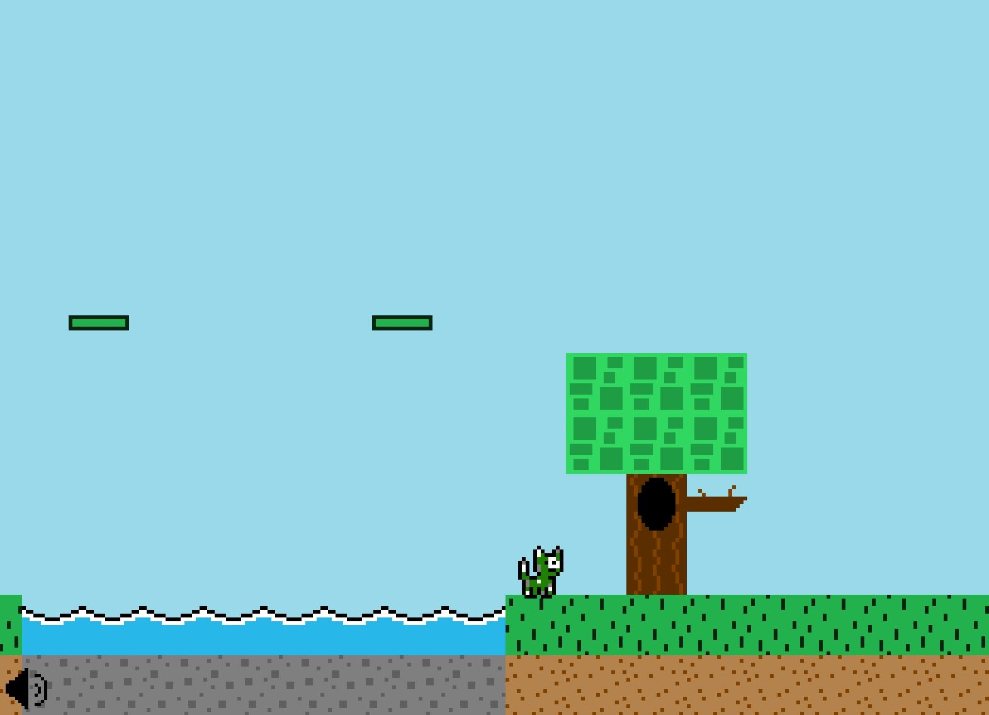
Notable Enhancement: Game Duration - Level 9

Slide 27
Other Enhancements
 | Detail | Scrum Sprint
Instruction Screen | Updated the instructions screen with new key mappings and made it legible. | 1
Menu Navigation | Allows the player to navigate menus in four directions instead of up and down. | 1
Mute Feature | Allows the player to mute the in-game sound | 2
Restructure Level 3 | Restructured Level 3 in order for the player to complete it. Was previously unbeatable. | 2
Single Shot Mechanic | Changed the attack animation to emit a single shot. | 3
Relocate Narrative Screen | Moved the Narrative Screen to appear before the player starts Level 1. | 3

Slide 28
Other Enhancements (cont.)
Name | Detail | Scrum Sprint
Level Completion Feedback | Changed the animation and sprite of the level completion box and added sound a effect. | 3
Attack Spawn Location | Lowered the spawn location of the attack projectile to hit smaller enemies. | 3
Improve and Restructure Old Levels | Redesigned old levels for variation. | 4
New Sound Effects | Added sound effects for jumping, attacking, enemy deaths. | 4
Level Selection Options | Added selection options for new levels | 4

Slide 29
Remaining Bugs and Enhancements
Name | Type | Detail
Cat Color Selection | Bug | When choosing a cat color from the options screen, the game immediately starts Level 1
Double Jump | Bug | Implementing a variable jump inadvertently enables the player to perform two small jumps
Player Lives | Enhancement | Add lives to add challenge
Timer | Enhancement | Add a timer for competitiveness
Scoreboard | Enhancement | Add a scoreboard for competitiveness
Difficulty Setting | Enhancement | Add difficulties for the expert players
Power-Ups | Enhancement | Implement power-ups for variability in gameplay

Slide 30

This Concludes Our Presentation
Thank You For Your Time

